Slide 1

Presentation Deck
Team: Turing’s Church
Project: Quantum Monte Carlo & Random Walk
WISER Quantum Project-2025

Slide 2
Table of Contents
What?
Why?
How?
The Conclusion?
What Next?
WISER Quantum Project-2025

Slide 3
What?
WISER Quantum Project-2025

Slide 4
Quantum Monte Carlo
What is this all about?
What we want to do?
Predict particle transport
Model stock market dynamics
What do we need?
Sample probability distributions
Statistical simulator
How do we do that?
Well, Monte Carlo
WISER Quantum Project-2025

Slide 5
The Power of Monte Carlo
Simulation
Optimization
Statistical Inference
Financial Modeling
Numerical integration
WISER Quantum Project-2025

Slide 6
Why?
WISER Quantum Project-2025

Slide 7
The Goal
Simulate a quantum Galton box
Reduce computational complexity
Maintain fidelity
Optimize for hardware implementation
Error mitigation and correction
Simulate other probability distributions
WISER Quantum Project-2025

Slide 8
Why Quantum?
WISER Quantum Project-2025

Slide 9
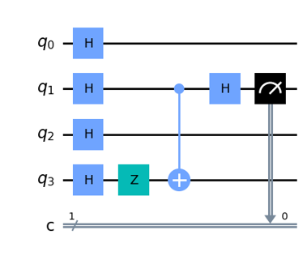
Quantum Monte Carlo
Sampling Speed-up
Universal Statistical Simulator
Higher Dimensional System Modeling
WISER Quantum Project-2025

Slide 10
How?
WISER Quantum Project-2025

Slide 11
The Approach
PauliX gate is used to activate the initial site of diffusion.
Hadamard/Rotation gate is used to specify amplitude.
CNOT gate is used to activate new sites of diffusion.
WISER Quantum Project-2025

Slide 12
Tools
Qiskit Transpiler
Qiskit Aer
Qiskit
WISER Quantum Project-2025

Slide 13
Technique
Decide number of steps
Activate the initial site of diffusion
Create superposition with desired amplitude
Use CNOT gates to activate more sites
Repeat until desired state is achieved
WISER Quantum Project-2025

Slide 14
Conclusion
WISER Quantum Project-2025

Slide 15
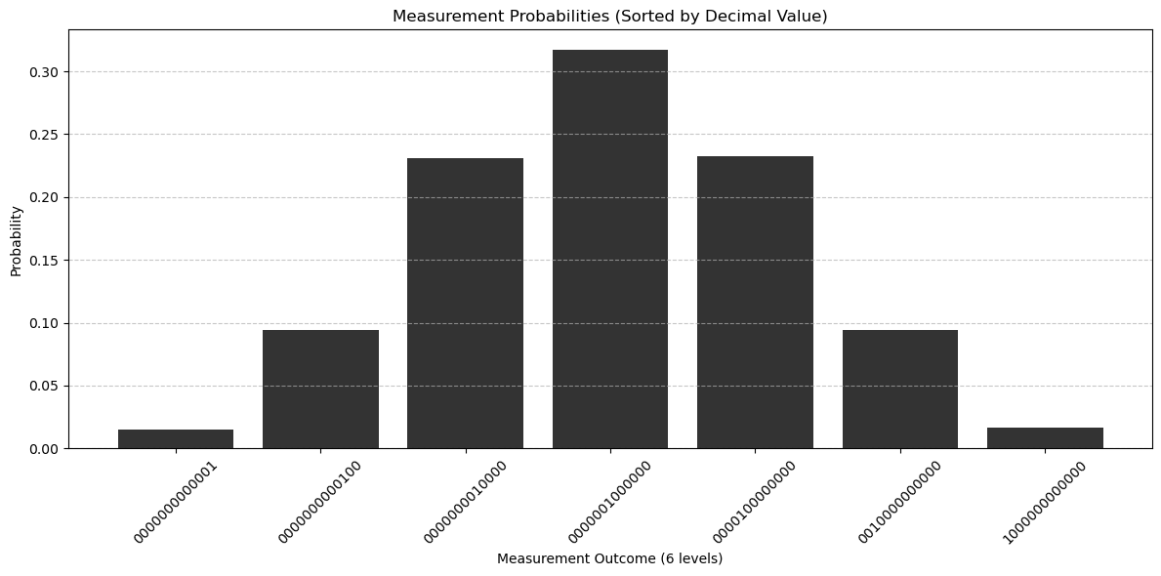
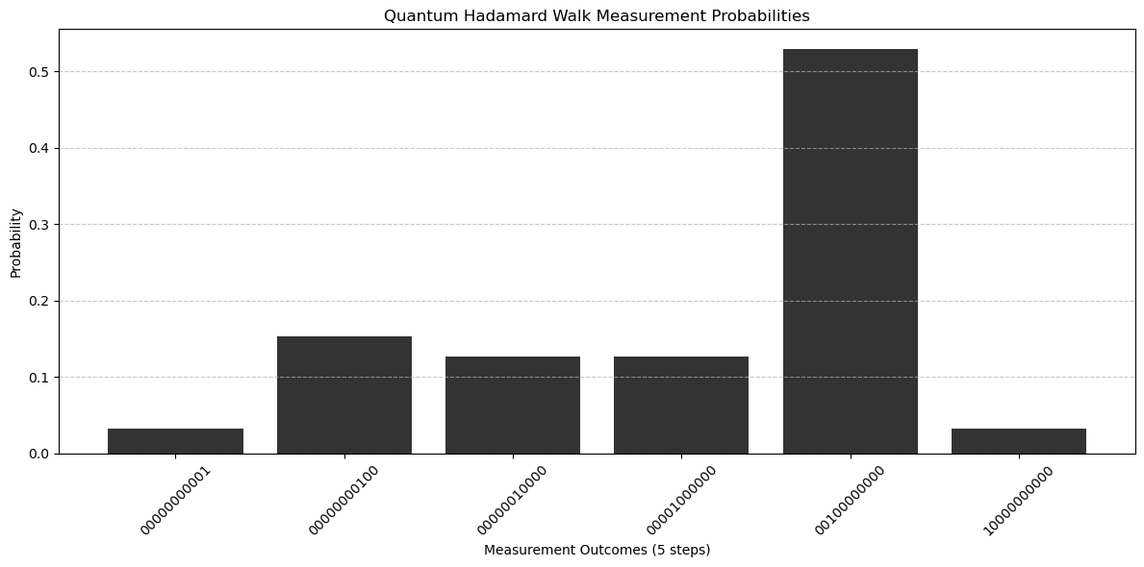
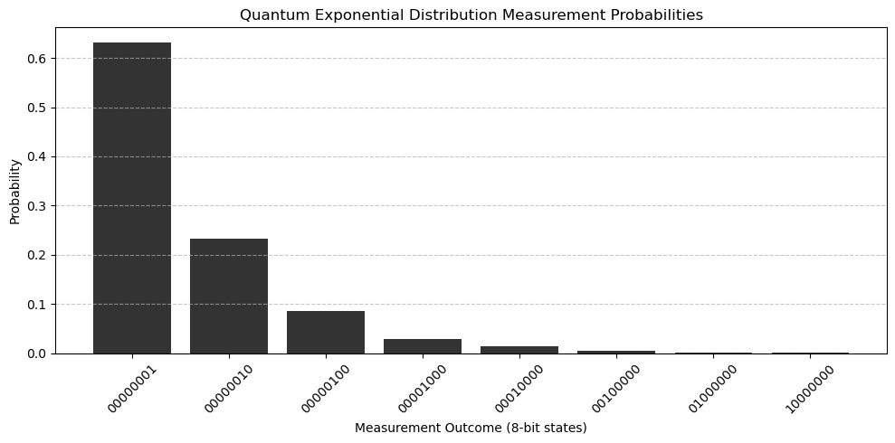
Distribution Results
WISER Quantum Project-2025

Slide 16
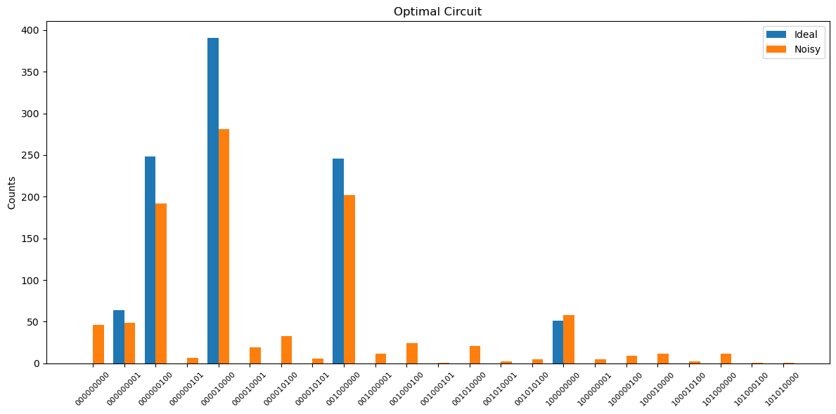
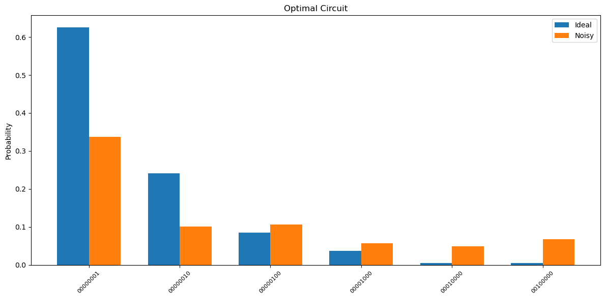
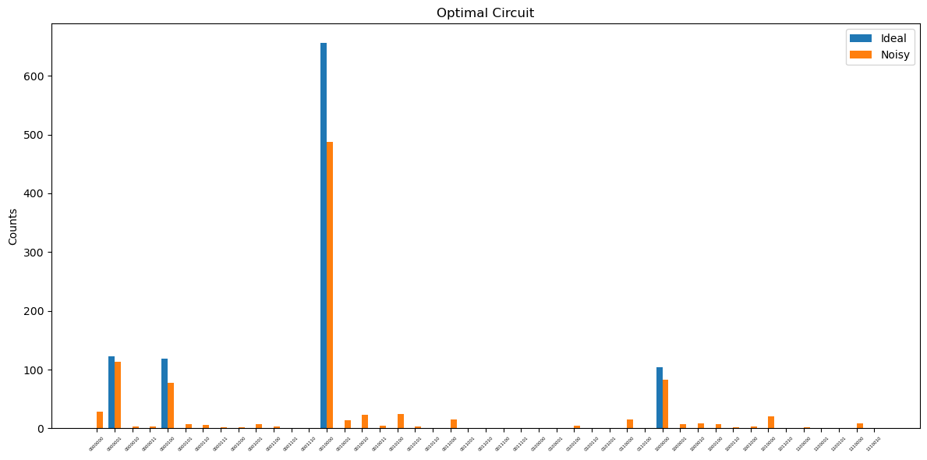
Optimization Results
WISER Quantum Project-2025

Slide 17
Outcome
Implemented Galton board for arbitrary steps
Distribution matched desired outcome
Extended the approach for other distributions
Optimized the circuit for noisy simulation
Evaluated the outcomes
WISER Quantum Project-2025

Slide 18
What Next?
WISER Quantum Project-2025

Slide 19

Final takeaways
Quantum gates can model statistical distributions
Simulation can be made efficient by optimization
Can be implemented using real hardware
Hybrid approach towards optimization works best
WISER Quantum Project-2025

Slide 20

Future Works
Quantum Monte Carlo in scientific simulations
Quantum search problem applications
Numerical modeling and analysis
Hybrid approach towards optimization works best
Hybrid approach of circuit transpilation
WISER Quantum Project-2025

Slide 21

Thank you
WISER Quantum Project-2025

